Slide 1
IoT based smart greenhouse &monitoring with analytics dashboard
Name: cabangile benga
Student no: 216536541
Subject: PJD301B

Slide 2
Introduction
Greenhouses are environments that are managed for plant/crop production.
Nature plays a vital role in the development of the plants. Thus, it’s quite difficult to control and maintain the correct weather conditions inside the greenhouse without the use of an automated control system that requires no human interaction.

Slide 3
Purpose of this project
Utilizing IoT technology to build a more intelligent, effective and sustainable growing environment is the goal of an IoT smart greenhouse.
It makes it possible to control a crop precisely, make data-driven decisions and manage it remotely, thereby optimizing crop yield while lowering resource use and the impact on the environment.

Slide 4

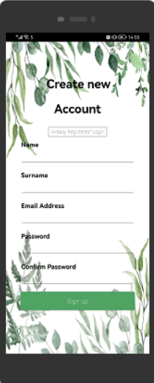
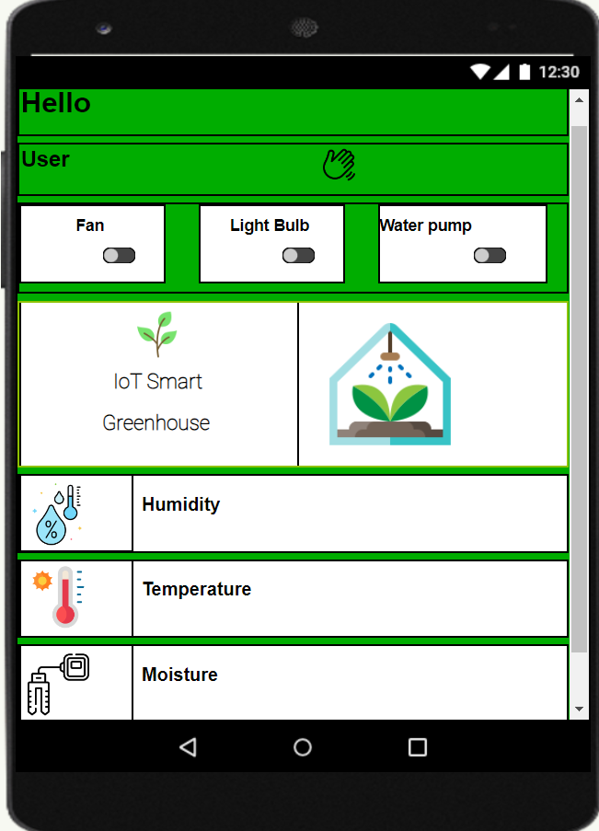
Capabilities
.
.
IoT based monitoring
Control desired weather conditions
Monitoring through mobile device
App provide security through login
Administrator may revoke rights of users
Uses a cloud database
Uses https communication(restful API)

Slide 5
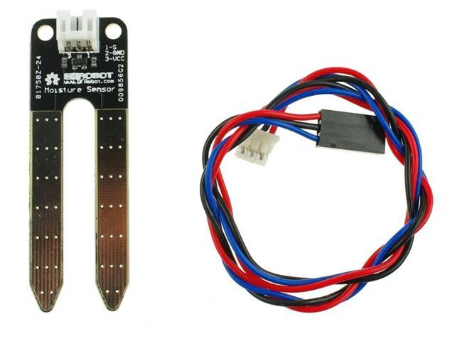
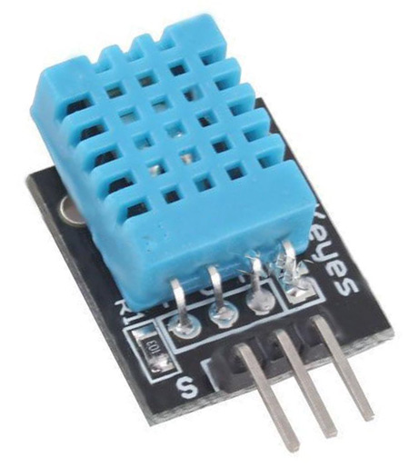
Hardware
Soil Moisture Sensor: Measures the amount of water in soil.
DHT11 Sensor: Is both a temperature and humidity sensor

Slide 6
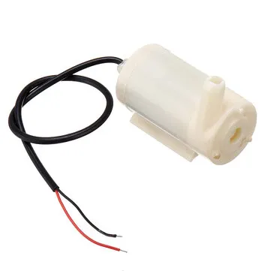
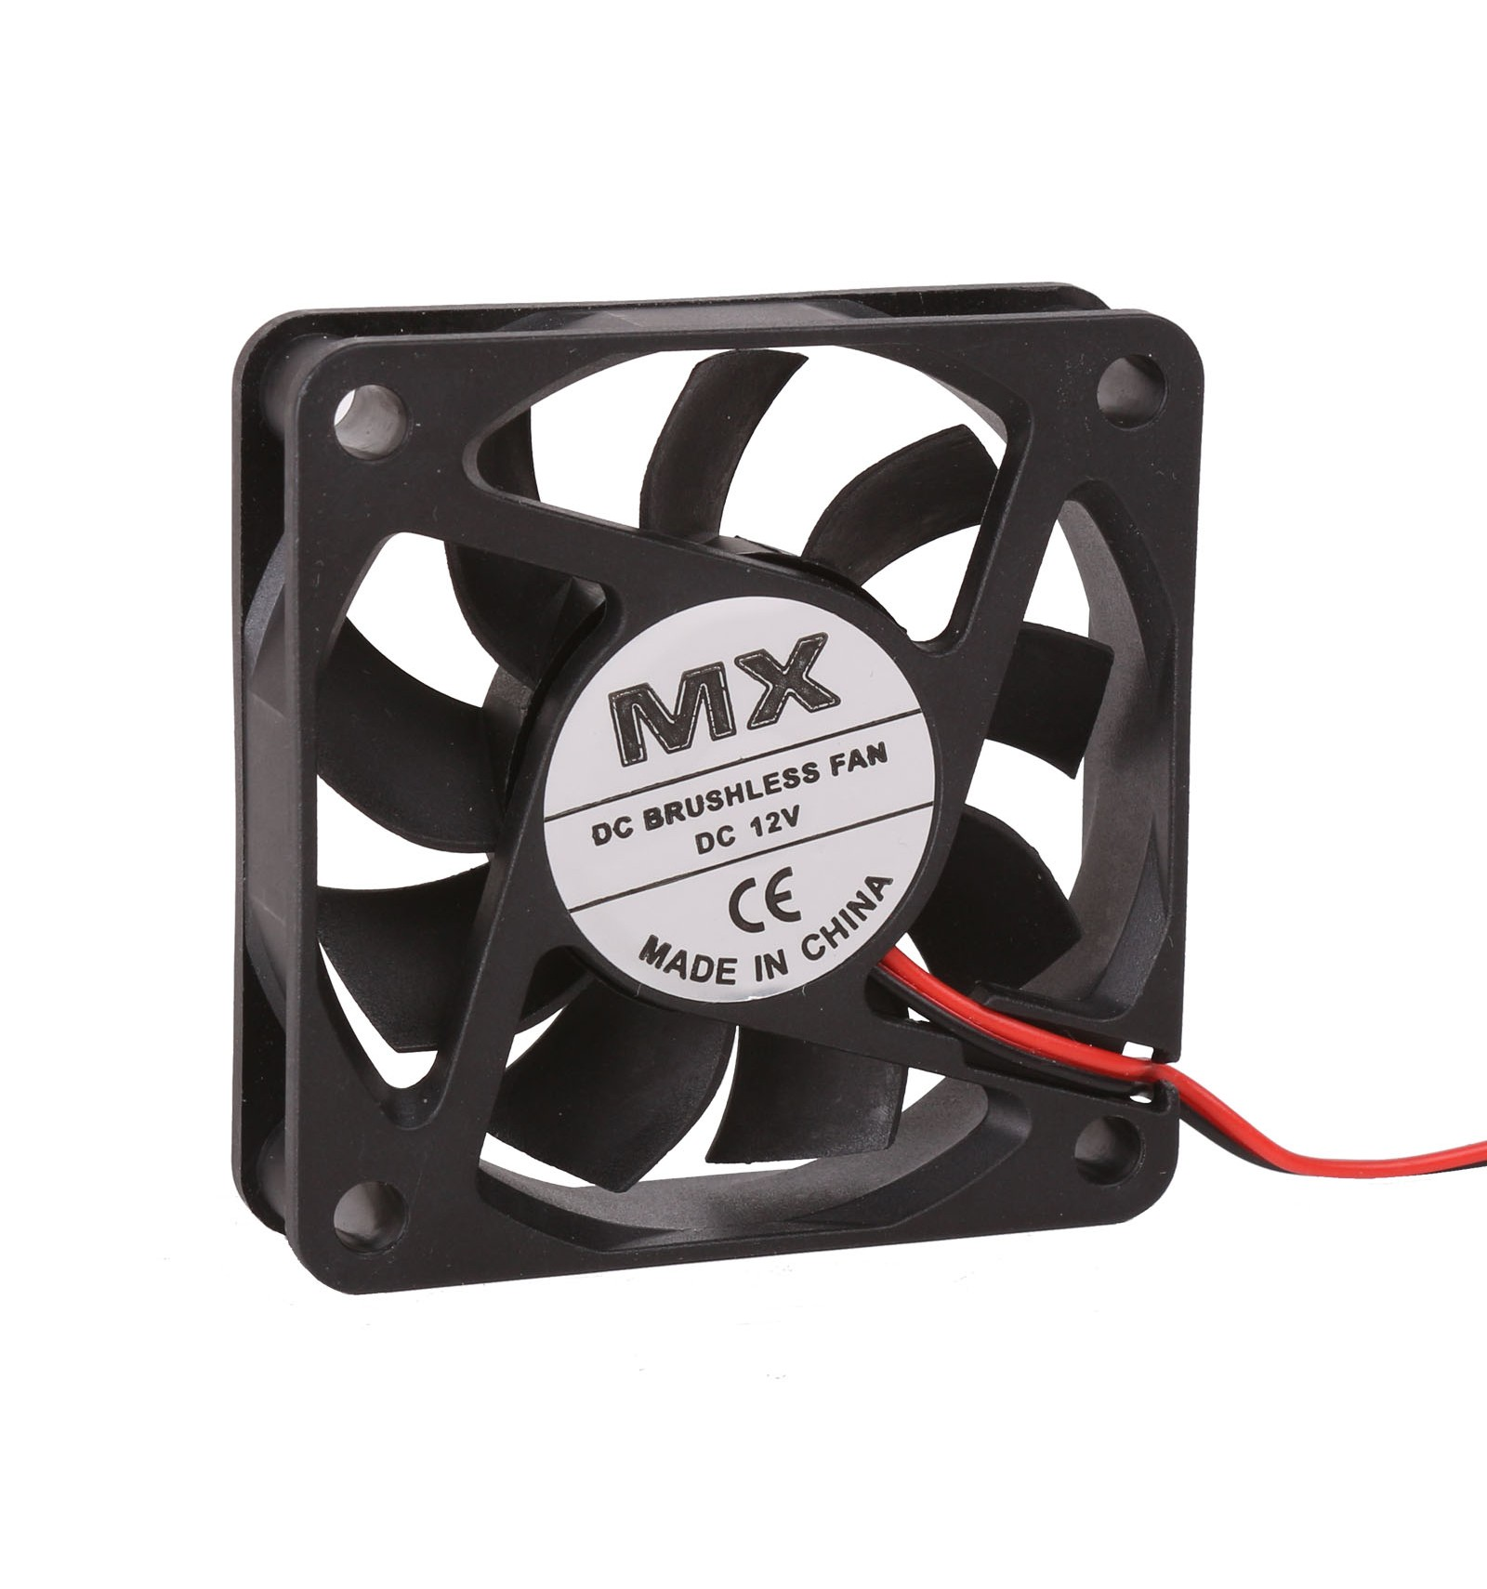
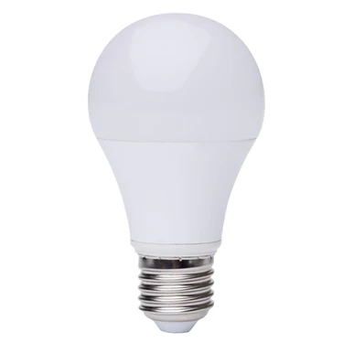
Hardware
Water pump
Fan
Light bulb
Activated when moisture is above the threshold
Activated when the temperature is too high
Activated when the temperature is too low

Slide 7
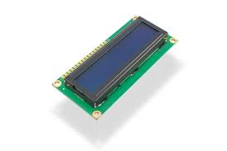
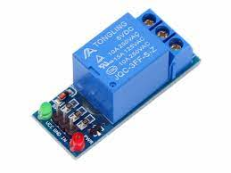
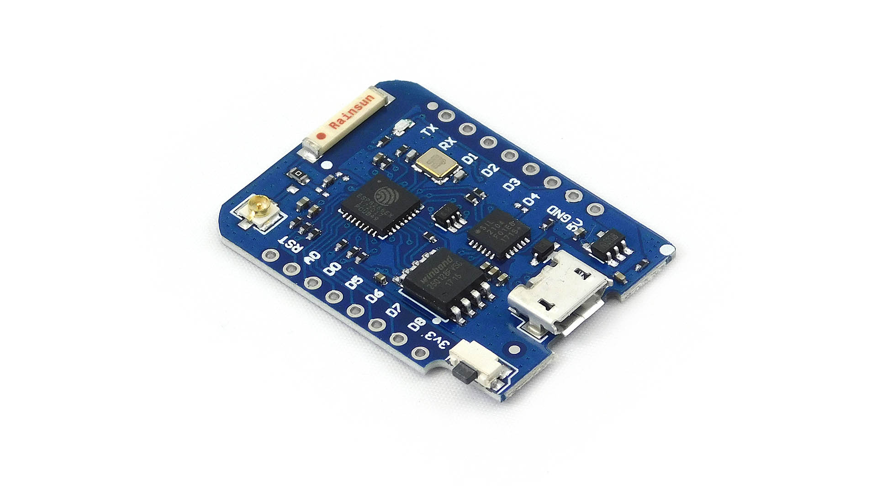
Hardware
LCD
Relay Module
ESP8266MOD
Display the welcome page, temperature and humidity
Acts as a switch
Wi-Fi-enabled microcontroller module

Slide 8
End

